Slide 1
Department of CSE, CSIT
COURSE NAME: Data science
COURSE CODE: 24AD3107
Topic:
Data science LIFE CYCLE
Session - 2

Slide 2
AIM OF THE SESSION
To familiarize students with the Data Science and it’s Challenges
INSTRUCTIONAL OBJECTIVES
This Session is designed to: Understand the Data Science and it’s Challenges
LEARNING OUTCOMES
At the end of this session, you should be able to: realize the Various Challenges of Data Science

Slide 3
SESSION INTRODUCTION
Key Concepts for Data Science:-
Data Collection
Data Cleaning
Exploratory Data Analysis
Machine Learning
Predictive Modeling
Data Visualization
Statistical Analysis
Decision Making
Challenges:-
Data Quality
Data Privacy
Scalability
Model Interpretability
Over fitting
Model Deployment
Talent Gap
Ethical Concerns

Slide 4
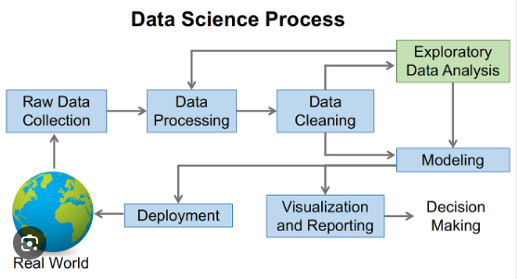
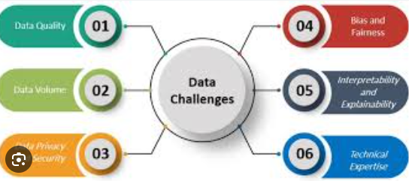
KEY CONCEPTS AND CHALLENGES FOR DATASCIENCE

Slide 5
DATA COLLECTION
Data collection refers to the process of gathering and acquiring data from various sources, such as surveys, sensors, or web scraping, to build datasets for analysis.
Key Points:-
Sources of Data
Types of Data (Structured, Unstructured)
Importance of Ethical and Legal Compliance
Visual: Icons representing different data sources (e.g., survey form, sensor, web page) and a database symbol to represent data collection.
4

Slide 6
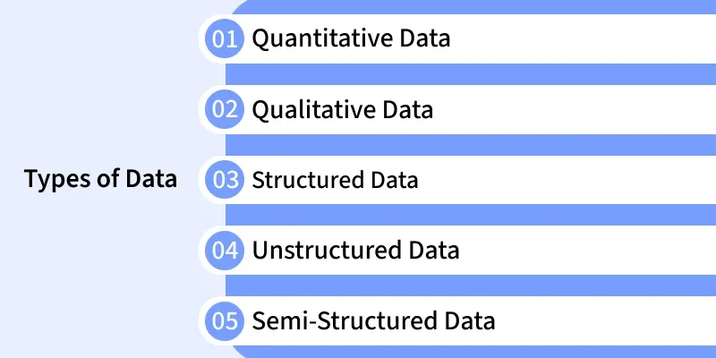
Quantitative data is information that can be measured, counted and expressed in numerical form. It provides objective values that can be analyzed statistically to identify patterns, trends and relationships.
Qualitative data is descriptive, non-numeric information that explains qualities, characteristics or categories rather than quantities. It helps understand opinions, experiences and meanings behind behaviors.
Structured data is information organized into a predefined format (rows and columns) that makes it easily searchable and manageable by traditional databases.
Unstructured data is raw information that does not follow a predefined structure or format making it harder to organize and analyze with conventional tools.
Semi-structured data combines aspects of structured and unstructured data. It does not reside in traditional tables but still contains tags or markers that provide a loose structure.

Slide 7
DATA CLEANING
Data cleaning, also known as data cleansing or data preprocessing, is the process of detecting and correcting errors, inconsistencies, and inaccuracies in datasets to ensure data quality and reliability for analysis.
Key Points:
  Identifying Missing Values
  Handling Duplicates
  Standardizing Data Formats
  Addressing Outliers and Anomalies
Visual: Icons representing data cleaning tasks (e.g., magnifying glass for identifying missing values, trash can for removing duplicates), and a visual depiction of data being refined or cleaned.
5

Slide 8
WHAT IS EXPLORATORY DATA ANALYSIS(EDA)and ML
  Definition:- EDA is the process of analyzing data sets to summarize their main characteristics, often with visual methods. It helps uncover patterns, identify anomalies, and test assumptions before applying more advanced analysis techniques.
Key Components:-
  Summary Statistics
  Data Visualization
  Data Cleaning and Preprocessing
  Definition:- Machine Learning is a subset of artificial intelligence that focuses on the development of algorithms allowing computers to learn from and make predictions or decisions based on data, without being explicitly programmed.
Key Components:-
  Training Data
  Model Building
  Prediction or Decision Making
5

Slide 9
WHAT IS PREDICTIVE MODELING?
Definition:- Predictive modeling is the process of using historical data to make predictions about future outcomes. It involves building statistical models that can forecast or estimate the likelihood of future events based on patterns and relationships identified in past data.
Importance:- Predictive modeling is crucial in various fields such as finance, healthcare, marketing, and manufacturing, as it helps organizations make informed decisions, anticipate trends, mitigate risks, and optimize processes.
Examples: Predicting customer churn, forecasting stock prices, diagnosing diseases, and detecting fraudulent activities.

Slide 10
WHAT IS DATA VISUALIZATION?
Definition: Data visualization is the graphical representation of information and data. It transforms complex datasets into visual formats, such as charts, graphs, and maps, to facilitate understanding, analysis, and communication.
Importance: Data visualization enables individuals and organizations to gain insights, identify patterns, detect trends, and communicate findings effectively. It helps in conveying information clearly and concisely, making it easier for stakeholders to make data-driven decisions.
Tools: Popular data visualization tools include Tableau, Power BI, ggplot2 (R), matplotlib (Python), and D3.js.

Slide 11
Statistical Analysis and Decision making
Definition: Statistical analysis is the process of collecting, exploring, summarizing, and interpreting data to uncover patterns, trends, relationships, and insights. It involves using statistical methods and techniques to analyze datasets and draw meaningful conclusions.
Importance: Statistical analysis is essential in various fields, including science, business, economics, social sciences, and healthcare. It helps in understanding data distributions, making predictions, testing hypotheses, and making informed decisions based on data-driven evidence.
Examples: Analyzing survey data, comparing treatment outcomes in clinical trials, predicting sales trends, and testing the effectiveness of marketing campaigns.

Slide 12
Statistical Analysis and Decision Making
Definition: Decision making is the process of selecting the best course of action from available alternatives to achieve a specific goal or objective. It involves identifying, evaluating, and choosing among different options based on available information, preferences, and constraints.
Importance: Decision making is crucial in both personal and professional contexts, influencing outcomes and shaping future directions. Effective decision making enables individuals and organizations to solve problems, seize opportunities, manage risks, and achieve desired outcomes.
Examples: Personal decisions such as choosing a career path, and organizational decisions such as launching a new product, investing in technology, or expanding into new markets.

Slide 13
Various Challenges for Data Science
Data Quality:-
Definition: Data quality refers to the accuracy, completeness, consistency, and reliability of data. Poor data quality can lead to inaccurate analysis and flawed insights.
Challenges:
  Missing Values: Incomplete or missing data points in datasets.
  Inconsistencies: Discrepancies or errors in data formatting or labeling.
  Data Bias: Systematic errors or inaccuracies in data collection that skew results.
  Data Integration: Difficulty in combining and reconciling data from multiple sources.
Impact: Poor data quality undermines the credibility and reliability of analytical findings, leading to incorrect conclusions and misguided decisions.

Slide 14
Various Challenges for Data Science
Data Privacy and Security:-
Definition: Data privacy and security involve protecting sensitive information from unauthorized access, disclosure, or misuse.
Challenges:
  Compliance: Adhering to regulations such as GDPR(General Data Protection Regulation), HIPAA (Health Insurance Portability and Accountability Act), or CCPA(California Consumer Privacy Act) that govern data privacy.
  Cyber security Threats: Risks of data breaches, hacking, and malicious attacks on data systems.
  Insider Threats: Unauthorized access or misuse of data by employees or insiders.
  Data Anonymization: Ensuring that personally identifiable information (PII) is properly anonymized to preserve privacy.
Impact: Failure to address data privacy and security challenges can result in legal liabilities, reputational damage, and loss of customer trust.

Slide 15
Various Challenges for Data Science
Scalability and Performance:-
Definition: Scalability and performance refer to the ability of data systems and algorithms to handle increasing volumes of data and deliver results in a timely manner.
Challenges:
  Big Data Processing: Managing and processing large-scale datasets efficiently.
  Computational Resources: Availability of sufficient computing power and storage capacity.
  Algorithm Efficiency: Optimizing algorithms to perform effectively on massive datasets.
  Real-Time Processing: Meeting the demand for real-time or near-real-time analysis and decision making.
Impact: Inadequate scalability and performance can lead to bottlenecks, delays, and inefficiencies in data processing, hindering business operations and decision making.

Slide 16
Various Challenges for Data Science
Interpretability and Explainability:-
Definition: Interpretability and explainability involve understanding and explaining the results and decisions made by data-driven models and algorithms.
Challenges:
  Black-Box Models: Lack of transparency in complex machine learning models, making it difficult to understand their inner workings.
  Bias and Fairness: Ensuring that models are fair and unbiased in their predictions and decisions.
  Model Complexity: Balancing model complexity with interpretability, especially in highly complex or nonlinear models.
  Stakeholder Understanding: Communicating technical insights and findings to non-technical stakeholders effectively.
Impact: Lack of interpretability and explainability can erode trust in data-driven systems, limit their adoption, and lead to unintended consequences or ethical issues.

Slide 17
Key Concepts for Data science themes and roles
Predictive Analytics
Machine Leaning
Data Visualization
Natural Language Processing(NLP)
Big Data Analytics
Data Scientist
Machine Learning Engineers
Data Engineer
Business Analyst
Data Architect

Slide 18
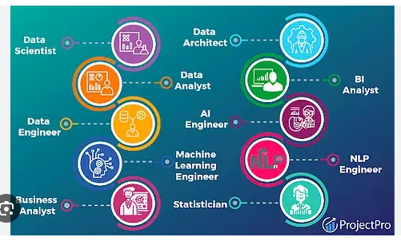
DATA SCIENCE THEMES AND ROLES
4

Slide 19
DATA SCIENCE THEMES
Predictive Analytics: Predictive analytics involves using historical data and statistical algorithms to forecast future outcomes. It is applied in various fields such as finance, marketing, healthcare, and manufacturing to make informed decisions and anticipate trends.
Machine Learning: Machine learning is a subset of artificial intelligence (AI) that focuses on developing algorithms and models that enable computers to learn from data and make predictions or decisions without being explicitly programmed. It encompasses techniques such as supervised learning, unsupervised learning, and reinforcement learning.
5

Slide 20
DATA SCIENCE THEMES
Data Visualization: Data visualization is the graphical representation of data and information to facilitate understanding, analysis, and communication. It involves creating visualizations such as charts, graphs, and maps to uncover patterns, trends, and insights in datasets.
Natural Language Processing (NLP): Natural language processing is a branch of AI that deals with the interaction between computers and human languages. It enables computers to understand, interpret, and generate human language, allowing for tasks such as sentiment analysis, text summarization, and language translation.
Big Data Analytics: Big data analytics involves the analysis of large and complex datasets that exceed the capabilities of traditional data processing applications. It encompasses techniques for storing, managing, and analyzing massive volumes of structured and unstructured data to extract valuable insights and support decision making.
5

Slide 21
DATA SCIENCE ROLES
Data Scientist: Data scientists are professionals who use their expertise in statistics, programming, and domain knowledge to analyze data, develop predictive models, and extract actionable insights. They often work with large datasets to solve complex problems and drive data-driven decision making.
Machine Learning Engineer: Machine learning engineers specialize in developing and implementing machine learning algorithms and models. They are responsible for training, testing, and deploying machine learning systems to solve specific business problems or automate tasks.

Slide 22
DATA SCIENCE ROLES
Data Engineer: Data engineers design, build, and maintain the infrastructure and systems for storing, processing, and analyzing data. They develop data pipelines, databases, and data warehouses to ensure data availability, reliability, and scalability for analytics and machine learning applications.
Business Analyst: Business analysts bridge the gap between data science and business stakeholders by translating business requirements into data-driven solutions. They conduct data analysis, generate reports, and provide insights to support strategic decision making and operational improvements.
Data Architect: Data architects design the overall structure and architecture of data systems and databases to ensure efficient data storage, retrieval, and analysis. They define data models, schemas, and integration strategies to support the organization's data needs and objectives.

Slide 23

THANK YOU
Team – DS

